Slide 1
CSCI 104 Hash Tables & Functions
Mark Redekopp
David Kempe
Sandra Batista
Aaron Cote’

Slide 2
Hash Tables
A hash table is an array that stores key,value pairs
Usually smaller than the size of possible set of keys, |S|
USC ID's = 10¹⁰ options
But larger than the expected number of keys to be entered (defined as n)
The table is coupled with a function, h(k), that maps keys to an integer in the range [0..tableSize-1] (i.e. [0 to m-1])
What are the considerations…
How big should the table be?
How to select a hash function?
What if two keys map to the same array location? (i.e. h(k1) == h(k2) )
Known as a collision
key
key, value
0
h(k)
1
2
3
4
…
tableSize-2
tableSize-1
m = tableSize
n = # of keys entered

Slide 3
Table Size
key
How big should our table be?
Example 1: We have 1000 employees with 3 digit IDs and want to store record for each
What is |S|? Expected n?
Solution 1: Keep array a[1000]. Let key be ID and location, so a[ID] holds employee record (no collisions)
Example 2: Using 5 letter ('a'-'z') nicknames for each student in a class.
|S| = 5²⁶ for classes of around n=100 students
Pick a hash table of some size much smaller (how many students do we have at any particular time)
key, value
0
h(k)
1
2
3
4
…
tableSize-2
tableSize-1
m = tableSize
n = # of keys entered

Slide 4
General Table Size Guidelines
key
The table size should be bigger than the amount of expected entries (m > n)
Don't pick a table size that is smaller than your expected number of entries
But anything smaller than the size of all possible keys admits the chance that two keys map to the same location in the table (a.k.a. COLLISION)
You will see that tableSize should usually be a prime number
key, value
0
h(k)
1
2
3
4
…
tableSize-2
tableSize-1
m = tableSize
n = # of keys entered

Slide 5
Hash Functions First Look
Challenge: Distribute keys to locations in hash table such that
Easy to compute and retrieve values given key
Keys evenly spread throughout the table
Distribution is consistent/repeatable for retrieval
If necessary key data type is converted to integer before hash is applied
Akin to the operator<() needed to use a data type as a key for the C++ map
Example: Strings
Use ASCII codes for each character and add them or group them
"hello" => 'h' = 104, 'e'=101, 'l' = 108, 'l' = 108, 'o' = 111 = 532
Hash function is then applied to the integer value 532 such that it maps to a value between 0 to M-1 where M is the table size

Slide 6
Possible Hash Functions
Define n = # of entries stored, m = Table Size, k is non-negative integer key
h(k) = 0 ?
h(k) = k mod m ?
h(k) = rand() mod m ?
Rules of thumb
The hash function should examine the entire search key, not just a few digits or a portion of the key
When modulo hashing is used, the base should be prime

Slide 7
Hash Function Goals
A "perfect hash function" should map each of the n keys to a unique location in the table
Recall that we will size our table to be larger than the expected number of keys…i.e. n < m
Perfect hash functions are not practically attainable
A "good" hash function or Universal Hash Function
Is easy and fast to compute
Scatters data uniformly throughout the hash table
P( h(k) = x ) = 1/m (i.e. pseudorandom)

Slide 8
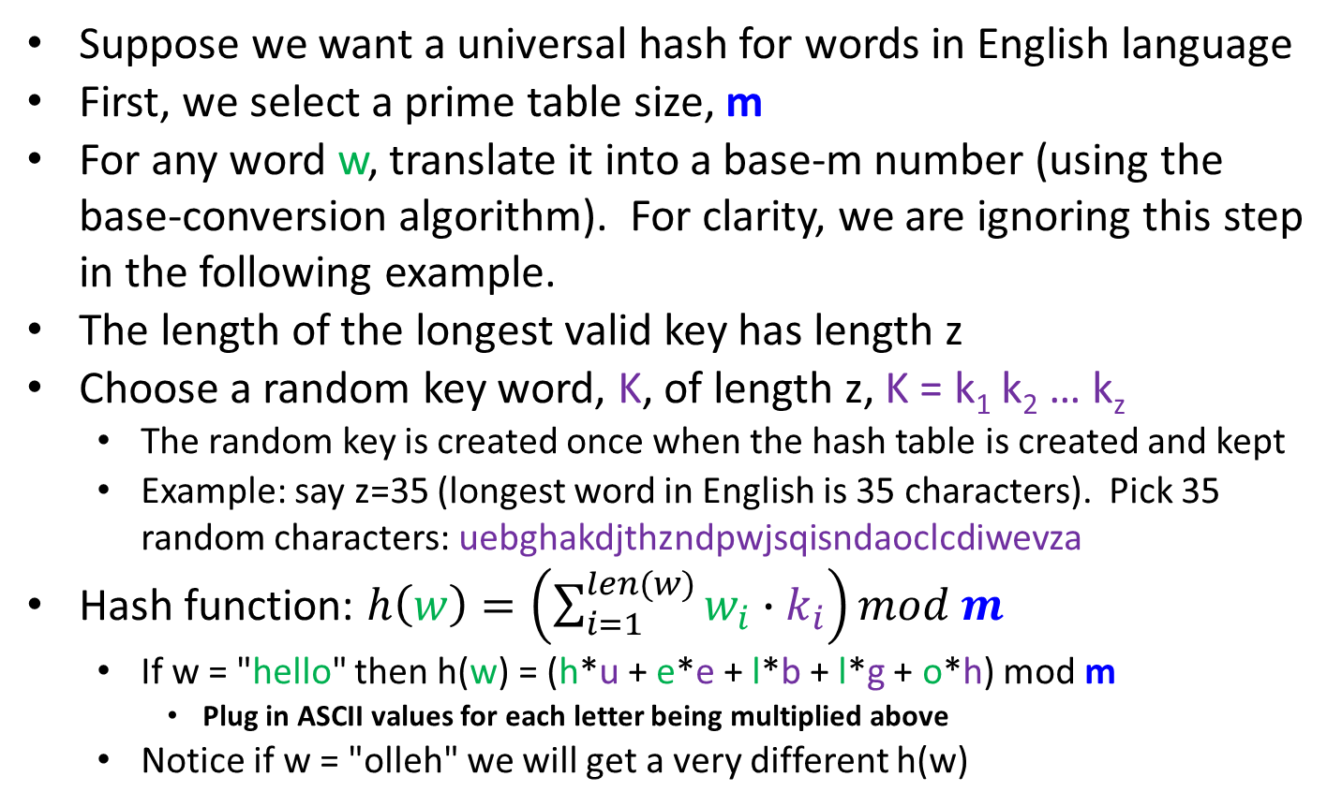
Universal Hash Example
Suppose we want a universal hash for words in English language
First, we select a prime table size, m
For any word w, translate it into a base-m number (using the base-conversion algorithm). For clarity, we are ignoring this step in the following example.
The length of the longest valid key has length z
Choose a random key word, K, of length z, K = k₁ k₂ … k_{z}
The random key is created once when the hash table is created and kept
Example: say z=35 (longest word in English is 35 characters). Pick 35 random characters: uebghakdjthzndpwjsqisndaoclcdiwevza
Hash function: $h\left(w\right)=\left(\sum_{i=1}^{len(w)}{w_{i}∙k_{i}}\right)mod m$
If w = "hello" then h(w) = (h*u + e*e + l*b + l*g + o*h) mod m
Plug in ASCII values for each letter being multiplied above
Notice if w = "olleh" we will get a very different h(w)

Slide 9
Resolving Collisions
Collisions occur when two keys, k1 and k2, are not equal, but h(k1) = h(k2).
Collisions are inevitable if the number of entries, n, is greater than table size, m (by pigeonhole principle) and are likely even before (by the birthday paradox)
Methods
Closed Addressing (e.g. buckets or chaining)
Open addressing (aka probing)
Linear Probing
Quadratic Probing
Double-hashing

Slide 10
Buckets/Chaining
k,v
Simply allow collisions to all occupy the location they hash to by making each entry in the table an ARRAY (bucket) or LINKED LIST (chain) of items/entries
Close Addressing => You will live in the location you hash to (it's just that there may be many places at that location)
Buckets
How big should you make each array?
Too much wasted space
Chaining
Each entry is a linked list
Bucket 0
…
1
…
2
…
3
…
4
…
…
tableSize-1
…
Array of Linked Lists
key, value
0
1
2
3
4
…
tableSize-1

Slide 11
Hashing Efficiency
Loading factor, α, defined as:
(n=number of items in the table) / m=tableSize => α = n / m
Really it is just the fraction of locations currently occupied
For chaining, α, can be greater than 1
This is because n > m
What is the average length of a chain in the table (e.g. 10 total items in a hash table with table size of 5)?
Best to keep the loading factor, α, below 1
Resize and rehash contents if load factor too large (using new hash function)

Slide 12
Hash Table Analysis
Assume a universal hash function, and α=1
When finding the item I’m looking for, how many other items, on average, will be in the same bucket?
(m-1)/m (Linearity of Expectation!)
On average, every item has 1 “roommate”.
Note that this is different than asking what the average bucket size is.

Slide 13
Open Addressing
Open addressing means an item with key, k, may not be located at h(k)
If location 2 is occupied and a new item hashes to location 2, we need to find another location to store it.
Let i be number of failed inserts
Linear Probing
h(k,i) = (h(k)+i) mod m
Example: If h(k) occupied (i.e. collision) then check h(k)+1, h(k)+2, h(k)+3, …
Quadratic Probing
h(k,i) = (h(k)+i^2) mod m
If h(k) occupied, then check h(k)+1², h(k)+2², h(k)+3², …
key
key, value
0
k, v
h(k)
1
2
k, v
3
k, v
4
…
tableSize-2
tableSize-1
k,v

Slide 14
Linear Probing Issues
key, value
If certain data patterns lead to many collisions, linear probing leads to clusters of occupied areas in the table called primary clustering
How would quadratic probing help fight primary clustering?
Quadratic probing tends to spread out data across the table by taking larger and larger steps until it finds an empty location
0
occupied
1
2
occupied
3
occupied
Linear Probing
4
…
tableSize-2
tableSize-1
occupied
key, value
0
occupied
1
2
occupied
3
occupied
Quadratic Probing
4
5
6
7
occupied

Slide 15
Find & Removal Considerations
key, value
Given linear or quadratic clustering how would you find a given key, value pair
First hash it
If it is not at h(k), then move on to the next items in the linear or quadratic sequence of locations until
you find it or
an empty location or
search the whole table
What if items get removed
Now the find algorithm might terminate too early
Mark a location as "removed"=unoccupied but part of a cluster
0
occupied
1
2
occupied
3
occupied
Linear Probing
4
…
tableSize-2
tableSize-1
occupied
key, value
0
occupied
1
2
occupied
3
occupied
Quadratic Probing
4
5
6
7
occupied

Slide 16
Practice
Use the hash function h(k)=k%10 to find the contents of a hash table (m=10) after inserting keys 1, 11, 2, 21, 12, 31, 41 using linear probing
Use the hash function h(k)=k%9 to find the contents of a hash table (m=9) after inserting keys 36, 27, 18, 9, 0 using quadratic probing
0 | 1 | 2 | 3 | 4 | 5 | 6 | 7 | 8 | 9
0 | 1 | 2 | 3 | 4 | 5 | 6 | 7 | 8

Slide 17
Practice
If your hash table size isn’t prime, bad things can happen!
Use the hash function h(k)=k%7 to find the contents of a hash table (m=10) after inserting keys 14, 8, 21, 2, 7 using quadratic probing
If your loading factor rises above 0.5, bad things can happen!
Quadratic probing only works well for prime table sizes, and keeping the load factor < 0.5
0 | 1 | 2 | 3 | 4 | 5 | 6

Slide 18
Quadratic Probing Number Theory
If your hash table has a prime size m, the first m/2 probes are guaranteed to go to distinct locations.
(h(k)+i²) % m = (h(k)+j²) % m
i² % m = j² % m
(i² - j²) % m = 0
(i+j)*(i-j) % m = 0
i,j ≤ m/2, and i ≠ j, so –m < i-j, and i+j < m
Since m is prime, you can’t divide m over (i+j) and (i-j)

Slide 19
Double Hashing
Define h₁(k) to map keys to a table location
But also define h₂(k) to produce a linear probing step size
First look at h₁(k)
Then if it is occupied, look at h₁(k) + h₂(k)
Then if it is occupied, look at h₁(k) + 2*h₂(k)
Then if it is occupied, look at h₁(k) + 3*h₂(k)
TableSize=13, h1(k) = k mod 13, and h2(k) = 5 – (k mod 5)
What sequence would I probe if k = 31
h1(31) = ___, h2(31) = _______________
Seq: ______________________________________________

Slide 20
Double Hashing
Define h₁(k) to map keys to a table location
But also define h₂(k) to produce a linear probing step size
First look at h₁(k)
Then if it is occupied, look at h₁(k) + h₂(k)
Then if it is occupied, look at h₁(k) + 2*h₂(k)
Then if it is occupied, look at h₁(k) + 3*h₂(k)
TableSize=13, h1(k) = k mod 13, and h2(k) = 5 – (k mod 5)
What sequence would I probe if k = 31
h1(31) = 5, h2(31) = 5-(31 mod 5) = 4
5, 9, 0, 4, 8, 12, 3, 7, 11, 2, 6, 10, 1

Slide 21
Rehashing for Open Addressing
For probing (open-addressing), as α approaches 1 the expected number of probles/comparisons will get very large
Capped at the tableSize, m (i.e. O(m))
Similar to resizing a vector, we can allocate a larger prime size table/array
Must rehash items to location in new table size.
Cannot just items to corresponding location in the new array
Example: h(k) = k % 13 != h'(k) = k %17 (e.g. k = 15)
For quadratic probing if table size m is prime, then first m/2 probes will go to unique locations
General guideline for probing: keep α < 0.5

Slide 22
Hash Tables
Suboperations
Compute h(k) should be _____
Array access of table[h(k)] = ____
In a hash table using chaining, what is the expected efficiency of each operation
Find = ______
Insert = ______
Remove = ______

Slide 23
Hash Tables
Suboperations
Compute h(k) should be O(1)
Array access of table[h(k)] = O(1)
In a hash table using chaining, what is the expected efficiency of each operation
Find = O(α ) = O(1) since α should be kept constant
Insert = O(α ) = O(1) since α should be kept constant
Remove = O(α ) = O(1) since α should be kept constant

Slide 24
Summary
45
Hash tables are LARGE arrays with a function that attempts to compute an index from the key
Open addressing keeps uses a fixed amount of memory but insertion/find times can grow large as α approaches 1
Closed addressing provides good insertion/find times as the number of entries increases at the cost of additional memory
The functions should spread the possible keys evenly over the table [i.e. p( h(k) = x ) = 1/m ]

Slide 25
HASH Functions

Slide 26
Recall: Hash Function Goals
A "perfect hash function" should map each of the n keys to a unique location in the table
Recall that we will size our table to be larger than the expected number of keys…i.e. n < m
Perfect hash functions are not practically attainable
A "good" hash function
Scatters data uniformly throughout the hash table
P( h(k) = x ) = 1/m (i.e. pseudorandom)

Slide 27
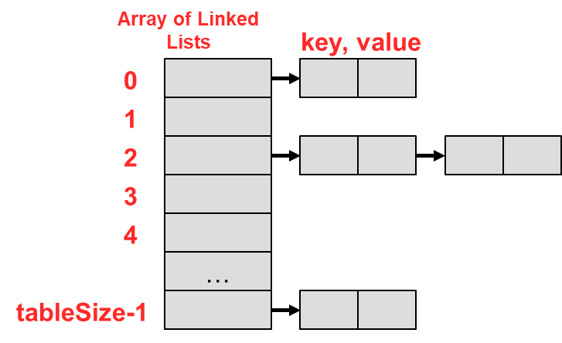
Pigeon Hole Principle
Recall for hash tables we let…
n = # of entries (i.e. keys), m = size of the hash table
If n > m, is every entry in the table used?
No. Some may be blank?
Is it possible we haven't had a collision?
No. Some entries have hashed to the same location
Pigeon Hole Principle says given n items to be slotted into m holes and n > m there is at least one hole with more than 1 item
So if n > m, we know we've had a collision
We can only avoid a collision when n < m

Slide 28
Why Prime Table Size (1)?
Simple hash function is h(k) = k mod m
If our data is not already an integer, convert it to an integer first
Recall m should be _____________
PRIME!!!
Say we didn't pick a prime number but some power of 10 (i.e. k mod 10^{d}) or power of 2 (i.e. 2^{d})…then any clustering in the lower order digits would cause collisions
Suppose h(k) = k mod 100
Suppose we hash your birth years
We'd have a lot of collisions around _____
Similarly in binary h(k) = k mod 2^{d} can easily be computed by taking the lower d-bits of the number
19 dec. => 10011 bin. and thus 19 mod 2² = 11 bin. = 3 decimal

Slide 29
Why Prime Table Size (2)
Let's suppose we have clustered data when we chose m=10^{d}
Assume we have a set of keys, S = {k, k', k"…} (i.e. 99, 199, 299, 2099, etc.) that all have the same value mod 10^{d} and thus the original clustering (i.e. all mapped to same place when m=10^{d})
Say we now switch and choose m to be a prime number (m=p)
What is the chance these numbers hash to the same location (i.e. still cluster) if we now use h(k) = (k mod m) [where m is prime]?
i.e. what is the chance (k mod 10^{d}) = (k mod p)

Slide 30
Why Prime Table Size (3)
Suppose two keys, k* and k’, map to same location mod m=10^{d} hash table => their remainders when they were divide by m would have to be the same => k*-k' would have to be a multiple of m=10^{d}
If k* and k’ map to same place also with new prime table size, p, then
k*-k' would have to be a multiple of 10^{d} and p
Recall what would the first common multiple of p and 10^{d} be?
So for k* and k' to map to the same place k*-k' would have to be some multiple p*10^{d}
i.e. 1*p*10^{d}, 2*p*10^{d}, 3*p*10^{d}, …
For p = 11 and d=2 => k*-k' would have to be 1100, 2200, 3300, etc.
Ex. k* = 1199 and k'=99 would map to the same place mod 11 and mod 10²
Ex. k* = 2299 and k'=99 would also map to the same place in both tables

Slide 31
Here's the Point
Here's the point…
For the values that used to ALL map to the same place like 99, 199, 299, 399…
Now, only every m-th one maps to the same place (99, 1199, 2299, etc.)
This means the chance of clustered data mapping to the same location when m is prime is 1/m
In fact 99, 199, 299, 399, etc. map to different locations mod 11
So by using a prime tableSize (m) and modulo hashing even clustered data in some other base is spread across the range of the table
Recall a good hashing function scatters even clustered data uniformly
Each k has a probability 1/m of hashing to a location

Slide 32
How Soon Would Collisions Occur
Even if α < 1 (i.e. n < m), how soon would we expect collisions to occur?
If we had an adversary…
Then maybe after the second insertion
The adversary would choose 2 keys that mapped to the same place
If we had a random assortment of keys…
Birthday paradox
Given n random values chosen from a range of size m, we would expect a duplicate random value in O(m^{1/2}) trials
For actual birthdays where m = 365, we expect a duplicate within the first 23 trials

Slide 33
Taking a Step Back
In most applications the UNIVERSE of possible keys >> M
Around 40,000 USC students each with 10-digit USC ID
n = 40000 and so we might choose m = 100,000 so α = 0.4
But there are 10¹⁰ potential keys (10-digit USC ID) hashing to a table of size 100,000
That means at least 10¹⁰/10⁵ could map to the same place no matter how "good" your hash function spreads data
What if an adversary fed those in to us and make performance degrade…
How can we try to mitigate the chances of this poor performance?
One option: Switch hash functions periodically
Second option: choose a hash function that makes engineering a sequence of collisions EXTREMELY hard (aka 1-way hash function)

Slide 34
One-Way Hash Functions
Fact of Life: What's hard to accomplish when you actually try is even harder to accomplish when you do not try
So if we have a hash function that would make it hard to find keys that collide (i.e. map to a given location, i) when we are trying to be an adversary…
…then under normal circumstances (when we are NOT trying to be adversarial) we would not expect to accidentally (or just in nature) produce a sequence of keys that leads to a lot of collisions
Main Point: If we can find a function where even though our adversary knows our function, they still can't find keys that will collide, then we would expect good performance under general operating conditions

Slide 35
One-Way Hash Function
h(k) = c = k mod 11
What would be an adversarial sequence of keys to make my hash table perform poorly?
It's easy to compute the inverse, h⁻¹(c) => k
Write an expression to enumerate an adversarial sequence?
11*i + c for i=0,1,2,3,…
We want hash function, h(k), where an inverse function, h⁻¹(c) is hard to compute
Said differently, we want a function where given a location, c, in the table it would be hard to find a key that maps to that location
We call these functions one-way hash functions or cryptographic hash functions
Given c, it is hard to find an input, k, such that h(k) = c
More on other properties and techniques for devising these in a future course
Popular examples: MD5, SHA-1, SHA-2

Slide 36
Uses of Cryptographic Hash Functions
Hash functions can be used for purposes other than hash tables
We can use a hash function to produce a "digest" (signature, fingerprint, checksum) of a longer message
It acts as a unique "signature" of the original content
The hash code can be used for purposes of authentication and validation
Send a message, m, and h(m) over a network.
The receiver gets the message, m', and computes h(m') which should match the value of h(m) that was attached
This ensures it wasn't corrupted accidentally or changed on purpose
We no longer need h(m) to be in the range of tableSize since we don't have a table anymore
The hash code is all we care about now
We can make the hash code much longer (64-bits => 16E+18 options, 128-bits => 256E+36 options) so that chances of collisions are hopefully miniscule (more chance of a hard drive error than a collision)
http://people.csail.mit.edu/shaih/pubs/Cryptographic-Hash-Functions.ppt

Slide 37
Another Example: Passwords
Should a company just store passwords plain text?
No
We could encrypt the passwords but here's an alternative
Just don't store the passwords!
Instead, store the hash codes of the passwords.
What's the implication?
Some alternative password might just hash to the same location but that probability can be set to be very small by choosing a "good" hash function
Remember the idea that if its hard to do when you try, the chance that it naturally happens is likely smaller
When someone logs in just hash the password they enter and see if it matches the hashcode.
If someone gets into your system and gets the hash codes, does that benefit them?
No!

Slide 38
Set Review
Recall the operations a set performs…
Insert(key)
Remove(key)
Contains(key) : bool (a.k.a. find() )
We can think of a set as just a map without values…just keys
We can implement a set using
List
O(n) for some of the three operations
(Balanced) Binary Search Tree
O(log n) insert/remove/contains
Hash table
O(1) insert/remove/contains
"Jordan"
"Frank"
"Percy"
"Anne"
"Greg"
"Tommy"

Slide 39
Bloom Filter Idea
Suppose you are looking to buy the next hot consumer device. You can only get it in stores (not online). Several stores who carry the device are sold out. Would you just start driving from store to store?
You'd probably call ahead and see if they have any left.
If the answer is "NO"…
There is no point in going…it's not like one will magically appear at the store
You save time
If the answer is "YES"
It's worth going…
Will they definitely have it when you get there?
Not necessarily…they may sell out while you are on your way
But overall this system would at least help you avoid wasting time

Slide 40
Bloom Filter Idea
A Bloom filter is a set such that "contains()" will quickly answer…
"No" correctly (i.e. if the key is not present)
"Yes" with a chance of being incorrect (i.e. the key may not be present but it might still say "yes")
Why would we want this?

Slide 41
Bloom Filter Motivation
Why would we want this?
A Bloom filter usually sits in front of an actual set/map
Suppose that set/map is EXPENSIVE to access
Maybe there is so much data that the set/map doesn't fit in memory and sits on a disk drive or another server as is common with most database systems
Disk/Network access = ~milliseconds
Memory access = ~nanoseconds
The Bloom filter holds a "duplicate" of the keys but uses FAR less memory and thus is cheap to access (because it can fit in memory)
We ask the Bloom filter if the set contains the key
If it answers "No" we don't have to spend time search the EXPENSIVE set
If it answers "Yes" we can go search the EXPENSIVE set

Slide 42
Bloom Filter Explanation
insert("Tommy")
A Bloom filter is…
A hash table of individual bits (Booleans: T/F)
A set of hash functions, {h₁(k), h₂(k), … h_{s}(k)}
Insert()
Apply each h_{i}(k) to the key
Set a[h_{i}(k)] = True
h1(k)
h2(k)
h3(k)
0
1
2
3
4
5
6
7
8
9
10
a
0
0
0
1
1
0
1
0
0
0
0
insert("Jill")
h1(k)
h2(k)
h3(k)
0
1
2
3
4
5
6
7
8
9
10
a
0
1
0
1
1
0
1
0
0
1
0

Slide 43
Bloom Filter Explanation
A Bloom filter is…
A hash table of individual bits (Booleans: T/F)
A set of hash functions, {h₁(k), h₂(k), … h_{s}(k)}
Contains()
Apply each h_{i}(k) to the key
Return True if all a[h_{i}(k)] = True
Return False otherwise
In other words, answer is "Maybe" or "No"
May produce "false positives"
May NOT produce "false negatives"
We will ignore removal for now
contains("Jill")
h1(k)
h2(k)
h3(k)
0
1
2
3
4
5
6
7
8
9
10
a
0
1
0
1
1
0
1
0
0
1
0
contains("John")
h1(k)
h2(k)
h3(k)
0
1
2
3
4
5
6
7
8
9
10
a
0
1
0
1
1
0
1
0
0
1
0

Slide 44
Implementation Details
Bloom filter's require only a bit per location, but modern computers read/write a full byte (8-bits) at a time or an int (32-bits) at a time
To not waste space and use only a bit per entry we'll need to use bitwise operators
For a Bloom filter with N-bits declare an array of N/8 unsigned char's (or N/32 unsigned ints)
unsigned char filter8[ ceil(N/8) ];
To set the k-th entry,
filter[ k/8 ] |= (1 << (k%8) );
To check the k-th entry
if ( filter[ k / 8] & (1 << (k%8) ) )
7
6
5
4
3
2
1
0
filter[0]
0
0
0
1
1
0
1
0
15
14
13
12
11
10
9
8
filter[1]
0
0
0
0
0
0
0
0

Slide 45
Practice
14
Trace a Bloom Filter on the following operations:
insert(0), insert(1), insert(2), insert(8), contains(2), contains(3), contains(4), contains(9)
The hash functions are
h1(k)=(7k+4)%10
h2(k) = (2k+1)%10
h3(k) = (5k+3)%10
The table size is 10 (m=10).
0
1
2
3
4
5
6
7
8
9
a
0
0
0
0
0
0
0
0
0
0

Slide 46
Probability of False Positives
What is the probability of a false positive?
Let's work our way up to the solution
Probability that one hash function selects or does not select a location x assuming "good" hash functions
P(h_{i}(k) = x) = ____________
P(h_{i}(k) ≠ x) = ____________
Probability that all j hash functions don't select a location
_____________
Probability that all n-entries in the table have not selected location x
_____________
Probability that a location x HAS been chosen by the previous n entries
_______________
Math factoid: For small y, e^{y} = 1+y (substitute y = -1/m)
_______________
Probability that all of the j hash functions find a location True once the table has n entries
_______________
h1(k)
h2(k)
h3(k)
0
1
2
3
4
5
6
7
8
9
10
a
0
0
0
1
1
0
1
0
0
0
0

Slide 47
Probability of False Positives
What is the probability of a false positive?
Let's work our way up to the solution
Probability that one hash function selects or does not select a location x assuming "good" hash functions
P(h_{i}(k) = x) = 1/m
P(h_{i}(k) ≠ x) = [1 – 1/m]
Probability that all j hash functions don't select a location
[1 – 1/m]^{j}
Probability that all n-entries in the table have not selected location x
[1 – 1/m]^{nj}
Probability that a location x HAS been chosen by the previous n entries
1 – [1 – 1/m]^{nj}
h1(k)
h2(k)
h3(k)
0
1
2
3
4
5
6
7
8
9
10
a
0
0
0
1
1
0
1
0
0
0
0

Slide 48
Sizing Analysis
Can also use this analysis to answer or a more "useful" question…
…To achieve a desired probability of false positive, what should the table size be to accommodate n entries?
Example: I want a probability of p=1/1000 for false positives when I store n=100 elements
m ≥ 2n*ln(1/p)
So for p=.001 we would need a table of m=14*n since ln(1000) ≈ 7
For 100 entries, we'd need 1400 bits in our Bloom filter
For p = .01 (1% false positives) need m=9.6*n (9.6 bits per key)
Optimal # of hash functions, j = ln(2) / α
So for p=.01 and α = 1/(9.2) would yield j ≈ 7 hash functions

Slide 49
Practice
14
Trace a Bloom Filter on the following operations:
insert(0), insert(1), insert(2), insert(8), contains(2), contains(3), contains(4), contains(9)
The hash functions are
h1(k)=(7k+4)%10
h2(k) = (2k+1)%10
h3(k) = (5k+3)%10
The table size is 10 (m=10).
0
1
2
3
4
5
6
7
8
9
a
0
0
0
0
0
0
0
0
0
0
 | H1(k) | H2(k) | H3(k) | Hit?
Insert(0) | 4 | 1 | 3 | N/A
Insert(1) | 1 | 3 | 8 | N/A
Insert(2) | 8 | 5 | 3 | N/A
Insert(8) | 0 | 7 | 3 | N/A
Contains(2) | 8 | 5 | 3 | Yes
Contains(3) | 5 | 7 | 8 | Yes
Contains(4) | 2 | 9 | 3 | No
Contains(9) | 7 | 9 | 8 | No

